Slide 1


Revolutionizing Emergency Healthcare in Developing India: An AI-Integrated Ambulance System for Timely Intervention in Critical Conditions
DEPARTMENT OF COMPUTER SCIENCE & ENGINEERING
Batch No: 01
P . Sai Ram 20RA1A0572
V . Sai Bharath 20RA1A0566
P . Sai Rohith 20RA1A0568
4th Year.
UNDER THE GUIDENCE OF :
MR . Dr. S. Kavitha
Head of the Department(CSE)

Slide 2
CONTENTS
UML Diagrams
Dataset Description
Results
Applications
System And Packages Requirements
Conclussion
Future Scope
Abstract
Introduction
Motivation
Literature Survey
Existing System
Drawbacks of Existing System
Proposed System
Block Diagram of Proposed System
Advantages

Slide 3
ABSTRACT
The field of emergency medical services (EMS) has undergone significant advancements over the years, with a focus on improving response times, patient care, and overall outcomes. The integration of artificial intelligence (AI) and human interaction technologies into ambulances represents a transformative approach to enhance emergency medical care.
Historically, ambulances have primarily been vehicles equipped with basic life support equipment and staffed by paramedics and emergency medical technicians to provide initial care during transportation to a medical facility but this system lacks in real-time data analysis and decision support tools.
AI can offer this facilities in emergency situations. The problem at hand is optimizing emergency medical responses and care through the integration of AI and human interaction technologies within ambulances.
This approach improve communication, data sharing, and coordination between ambulances, hospitals, and other healthcare entities.

Slide 4
INTRODUCTION
In developing countries like India, accessing timely emergency medical care in remote areas is a critical challenge. Inadequate infrastructure leads to delays in response times and poor patient outcomes.
Factors such as inadequate communication systems, limited resources, and a shortage of trained medical personnel further exacerbate these challenges, particularly in rural and underserved communities.
The implementation of an AI-integrated ambulance system designed to revolutionize emergency healthcare delivery in India. This system harnesses the power of artificial intelligence (AI) and advanced technologies to enhance the efficiency, effectiveness, and responsiveness of emergency medical services, particularly in critical conditions where timely intervention is paramount.
The aim of this project is to outline the key components, functionalities, and potential impact of the proposed AI-integrated ambulance system, highlighting its potential to transform emergency healthcare in India.
By leveraging predictive analytics, intelligent routing, telemedicine capabilities, and AI-driven decision support systems, the ambulance system seeks to optimize resource allocation, reduce response times, and improve patient outcomes, ultimately saving lives and mitigating the burden on the healthcare system.

Slide 5
MOTIVATION
The motivation behind researching and implementing AI and human interaction technologies in the realm of emergency medical services (EMS) stems from the continual evolution of this field, aiming to enhance response times, elevate patient care standards, and optimize overall outcomes.
The backdrop of this research encompasses the dynamic progress of EMS, the pervasive influence of artificial intelligence (AI) in healthcare, and the promising potential for synergies between technological innovations and human interactions, especially in critical emergency situations.
Their primary role involves providing initial care during the transportation of patients to medical facilities. However, the historical EMS system faced challenges, including manual and time-consuming communication processes with hospitals and the processing of patient information.
By enhancing access to timely emergency medical care, especially in underserved communities, we can contribute to the achievement of universal health coverage, reduce health inequalities, and promote the well-being of individuals and communities across India.

Slide 6
LITERATURE SURVEY
In 2020 Akca et al. put forward a paper which mainly emphasizes on “Intelligent Ambulance Management System in Smart Cities.” technique to manage ambulance and emergency services. This research is efficient to cover all the things needed to Design & Development of Intelligent Ambulance Concept – AI and Human Interface Technology.
In 2021 Ganesh et al. presented a study on “health machine to handle covid-19 related health emergencies” technique to manage ambulance and emergency services. This research effectively covers all the requirements for developing a smart ambulance management framework, but it falls short on describing how the system may function in real time by combining mobile, cloud, and standalone applications altogether.
Gargi Beri et al. presented a study on “Intelligent Ambulance with Traffic Control” . This study includes a traffic control system as well as a health monitoring system. In health monitoring system, the patient's vital health parameters such as ECG, Heart Rate and Body Temperature are monitored. . These parameters are sent to a PC in ambulance via serial communication and this data will be sent to the hospital server.

Slide 7
Ms. Aisha Meethian Proposed a study on “IoT Based Traffic Control System with Patient Health Monitoring For Ambulance” in August 2022 . The proposed system optimizes the route by minimizing the transport duration to the hospital by using GPS sensor networks. The health parameter of the patient is monitored using different sensors like Heart Rate Sensor, Breath Sensor and Temperature Sensor . These parameters collected from the patient are transmitted to the hospital’s database using IOT.
In 2022 Timothy Malche et.al. proposed a system m consists of a sensor node to track patients’ vitals during different activities which patients perform. The proposed sensor node collects patients’ data using the sensors attached to the Development Kit (DK). The connected sensors are accelerometer, microphone, pulse oximeter, heart rate sensor, and temperature sensor. The accelerometer enables monitoring different patient physical activities, including walking, sleeping, exercising, and running. By analyzing the vitals during different activities, the doctor can prescribe treatment or give suggestions to patients.
In 2020, Yuanyuan Pan et.al. proposed an Enhanced Deep Convolutional Neural Network (EDCNN) for the early detection and diagnosis of heart disease. This research focuses on developing the EDCNN approach to identify heart disorders in patients and enhance diagnostic precision using deep learning-based prediction models. The prediction of heart disease involves processing patient data to calculate the likelihood of heart ailments, which has been mathematically computed using distributive functions. Heart activity is analyzed during exercise, resting, and working phases.

Slide 8
EXISTING SYSTEM
Decision Tree Classifier
DTC is a popular machine learning algorithm that belongs to the supervised learning technique. It can be used for both Classification and Regression problems in ML. It is based on the concept of ensemble learning, which is a process of combining multiple classifiers to solve a complex problem and to improve the performance of the model.
DTC is a classifier that contains a number of decision trees on various subsets of the given dataset and takes the average to improve the predictive accuracy of that dataset.
Instead of relying on one decision tree, the DTC takes the prediction from each tree and based on the majority votes of predictions, and it predicts the final output. The greater number of trees in the forest leads to higher accuracy and prevents the problem of overfitting.

Slide 9
DRAWBACKS OF EXISTING SYSTEM
Overfitting: Decision Trees are prone to overfitting, especially when the tree becomes too deep and complex. Overfitting occurs when the tree captures noise in the training data rather than the underlying patterns
Instability: Decision Trees are sensitive to small variations in the training data. A slight change in the data can result in a significantly different tree structure
Lack of Predictive Power: Decision Trees may struggle with capturing complex relationships in the data, especially when the relationships are nonlinear.
Difficulty Handling Missing Data: Traditional Decision Trees can struggle with missing data. If a predictor has missing values, the algorithm may discard the entire data point or introduce bias in the model.
Not Optimized for Unstructured Data: Decision Trees are not well-suited for unstructured data types like text

Slide 10
PROPOSED SYSTEM
The aim of this project is to develop an intelligent ambulance dispatch system that can predict critical medical conditions and prioritize ambulance dispatch accordingly. The system integrates various machine learning algorithms to analyze patient data and make real-time decisions for timely intervention
The essence of the AI-driven approach involves training these models on meticulously labeled datasets containing examples of different surfaces. Through this training process, the models can autonomously learn to extract relevant features from sensor data, enabling the robot to discern and classify surfaces with heightened accuracy.
The system utilizes machine learning algorithms to analyze patient data and predict the severity of medical conditions. Algorithms such as Decision Tree Classifier (DTC), K-Nearest Neighbors (KNN), Random Forest are used.

Slide 11
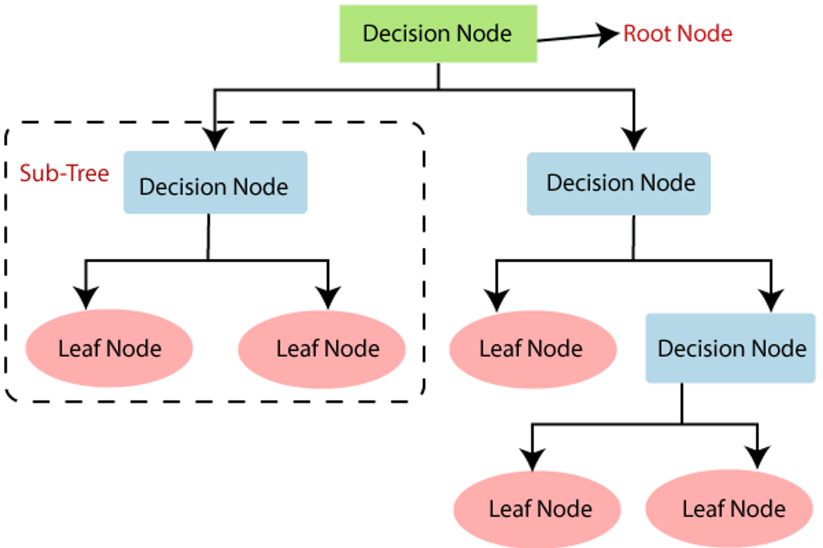
Decision Tree Classifier:
Decision Tree algorithm belongs to the family of supervised learning algorithms. Unlike other supervised learning algorithms, the decision tree algorithm can be used for solving regression and classification problems
The goal of using a Decision Tree is to create a training model that can use to predict the class or value of the target variable by learning simple decision rules inferred from prior data(training data)
In Decision Trees, for predicting a class label for a record we start from the root of the tree. We compare the values of the root attribute with the record’s attribute. On the basis of comparison, we follow the branch corresponding to that value and jump to the next node

Slide 12
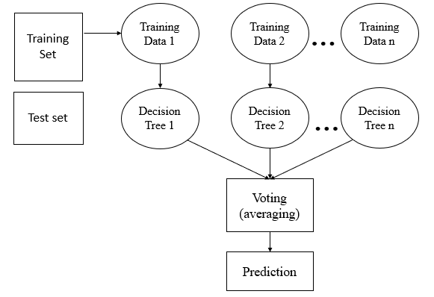
RANDOM FOREST ALOGRITHM :
Random Forest is a popular ensemble learning algorithm used in both classification and regression tasks. It operates by constructing a multitude of decision trees during training and outputting the class (classification) or mean prediction (regression) of the individual trees. The output of Random Forest is determined by averaging the outputs of individual trees (for regression) or by taking a majority vote (for classification).

Slide 13
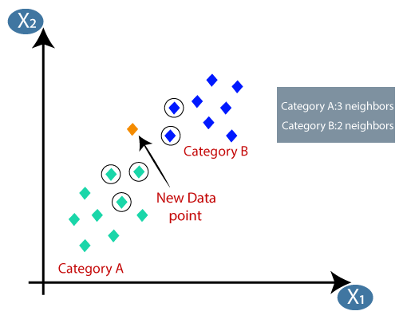
K-Nearest Neighbors (KNN) :
During the training phase, the KNN algorithm stores the entire training dataset as a reference. When making predictions, it calculates the distance between the input data point and all the training examples, using a chosen distance metric such as Euclidean distance.
Next, the algorithm identifies the K nearest neighbors to the input data point based on their distances. In the case of classification, the algorithm assigns the most common class label among the K neighbors as the predicted label for the input data point
The KNN algorithm is straightforward and easy to understand, making it a popular choice in various domains. However, its performance can be affected by the choice of K and the distance metric, so careful parameter tuning is necessary for optimal results.

Slide 14
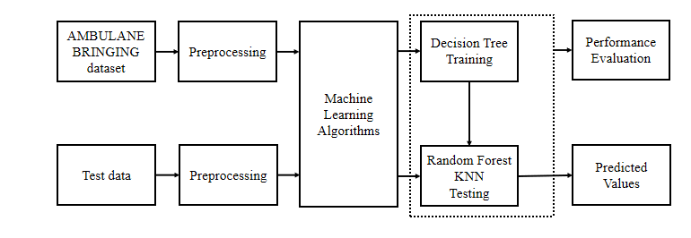
Block Diagram of proposed system :

Slide 15
ADVANTAGES
Timely Intervention:
AI algorithms can analyze patient data in real-time, enabling early detection of critical conditions
and prompt intervention
Enhanced Triage:
This can help prioritize patients based on the severity of their condition, ensuring that
critical cases receive immediate attention while less urgent cases are appropriately managed
Multiple Classifier Options:
The inclusion of both Decision Tree and Random Forest classifiers offers flexibility to users. They can
choose between different algorithms based on the nature of their data and the problem at hand, allowing
for experimentation and model comparison
Data Integration with Hospitals:
Seamless integration with hospital systems to ensure continuity of care and enable healthcare providers
to prepare for incoming patients more effectively.
User-Friendly Interface:
The graphical user interface (GUI) created with Tkinter enhances user interaction by providing buttons for
various functionalities. This makes the application accessible and easy to use for individuals without
programming expertise

Slide 16
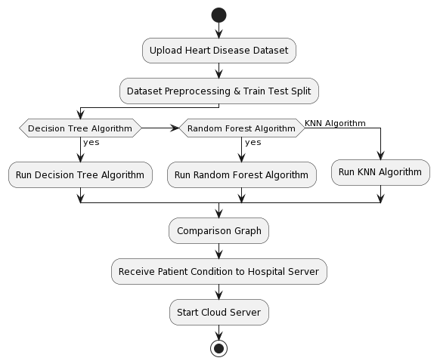
UML DIAGRAMS
Activity diagram:

Slide 17
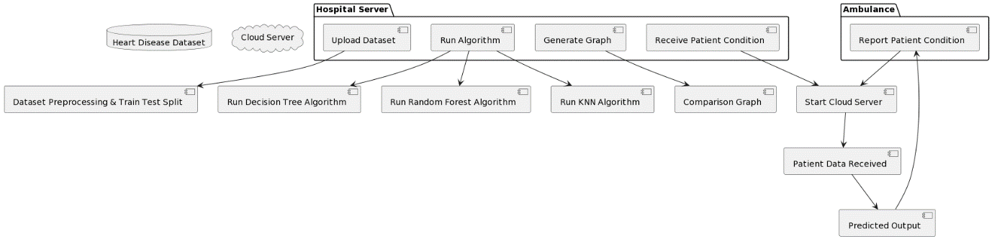
Data flow diagram :

Slide 18
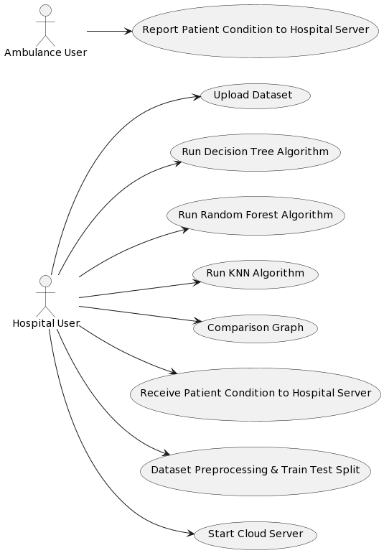
Use case diagram:

Slide 19
Dataset Description
This dataset contain various features related to patients' health attributes and diagnostic tests, with the target variable indicating the presence or absence of heart disease
Each row provides information about a patient's health status, risk factors, and diagnostic test results such as Resting blood pressure,
cholesterol level , Maximum heart rate, Resting electrocardiographic
results, Chest pain type experienced by the patient etc.
the target column Indicates the presence of heart disease (1 = condition Abnormal, 0 = Conditon Normal).

Slide 20
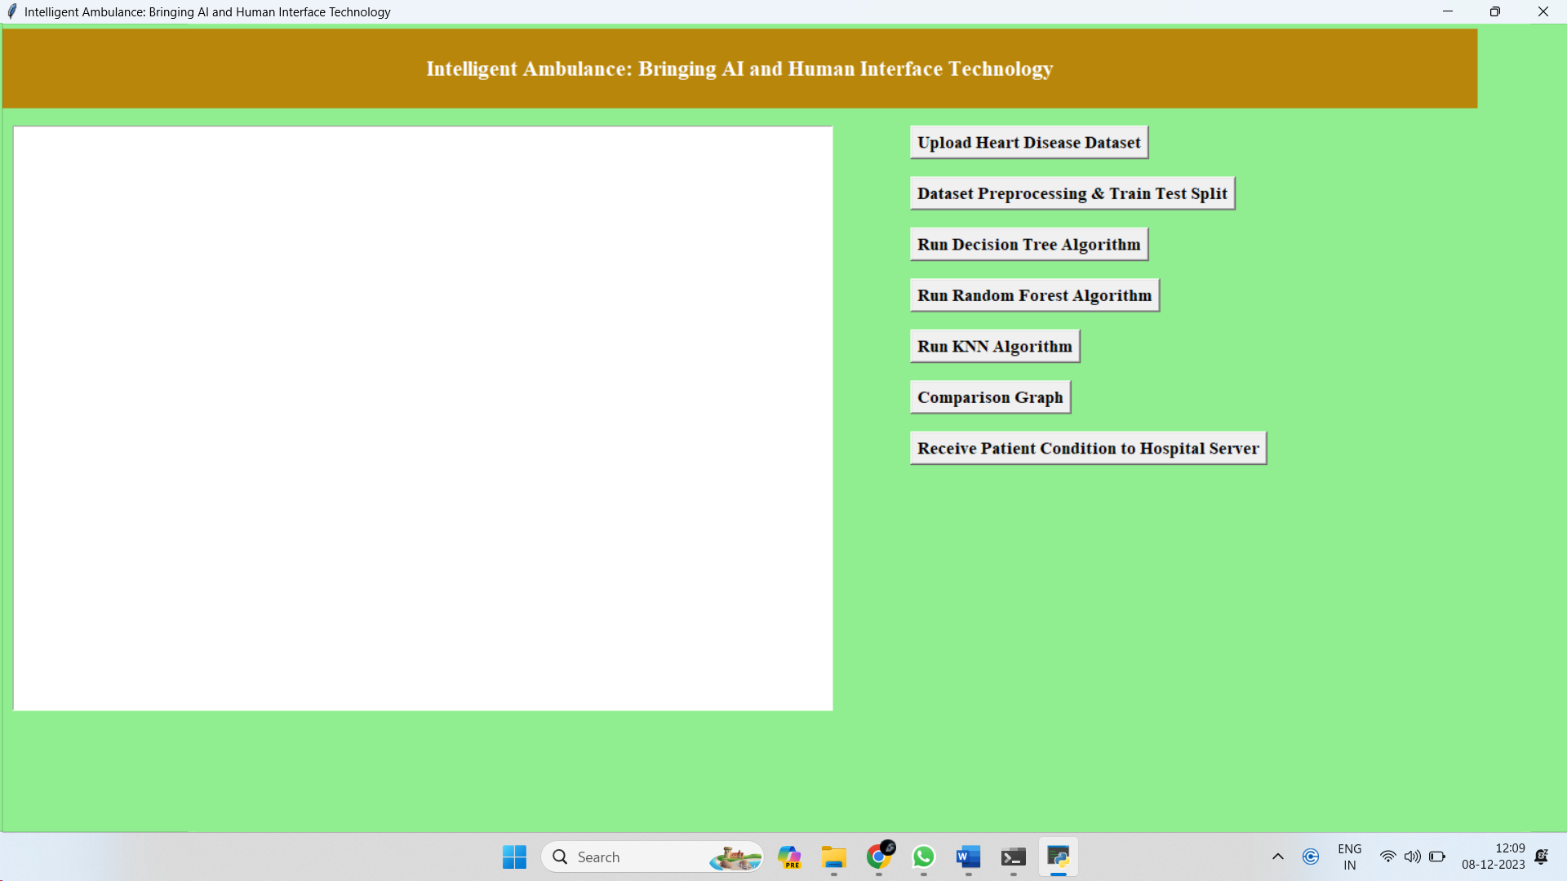
Results:
primary interface of the hospital server application for managing and processing ambulance-related data intelligently:

Slide 21
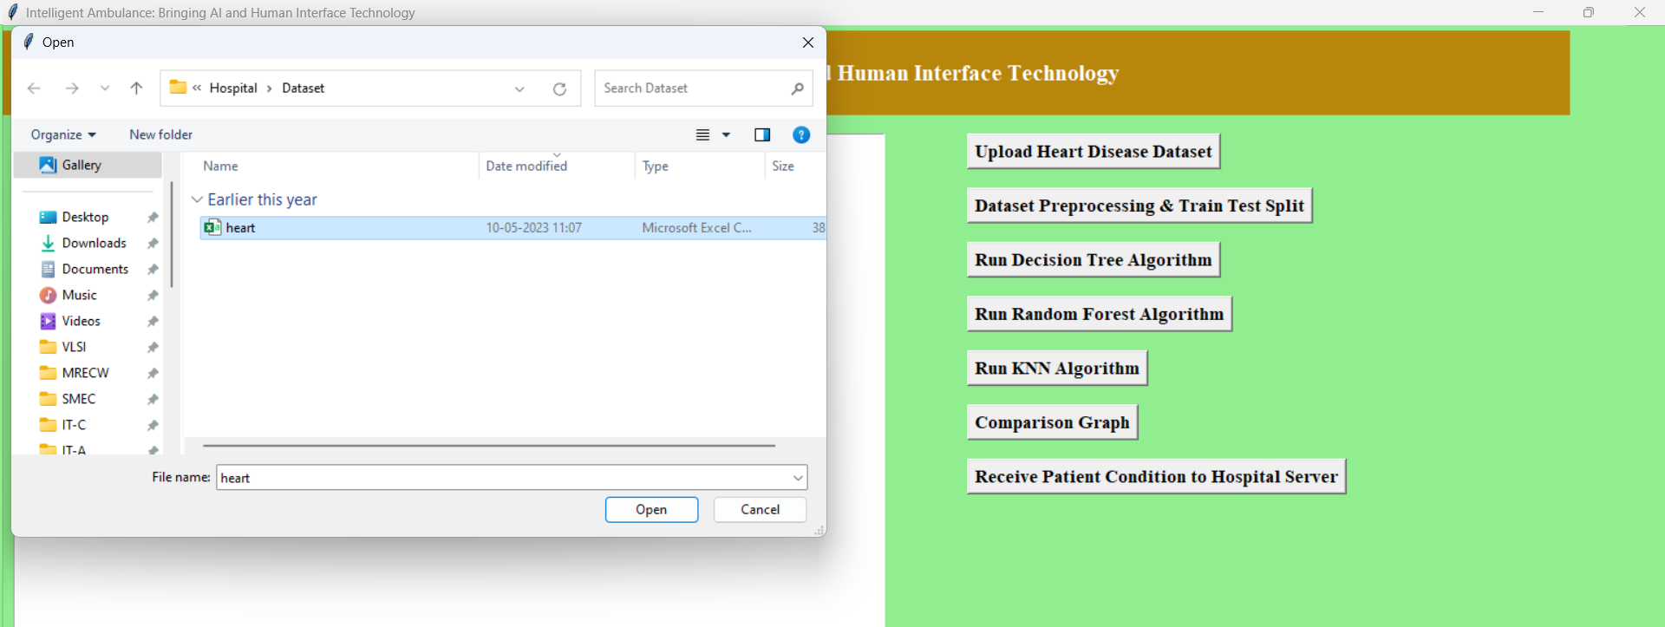
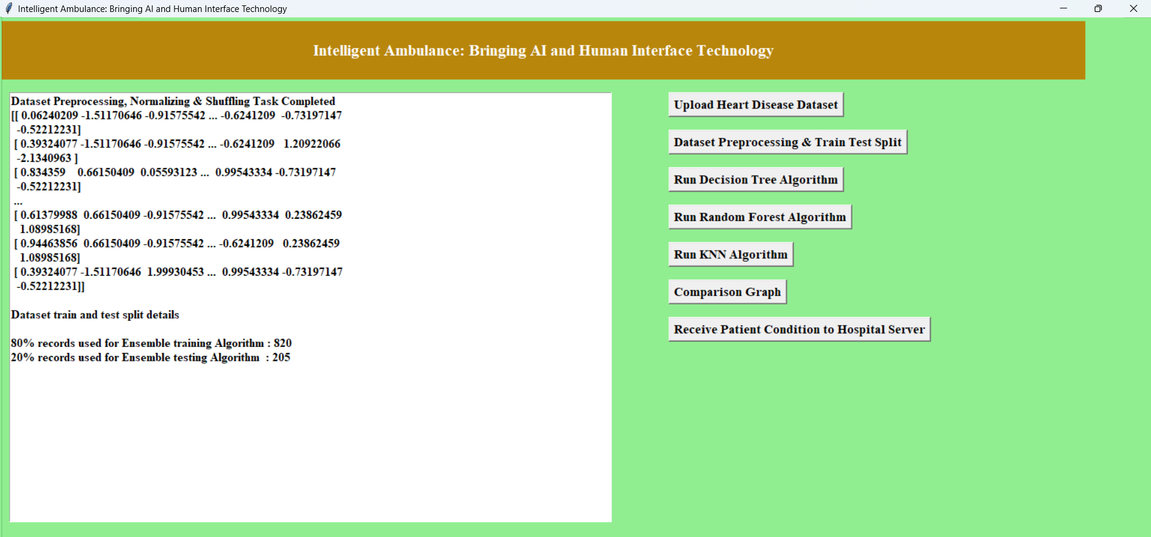
Selecting the dataset in the GUI application for model training :
Presents the pre-processed data from the dataset :

Slide 22
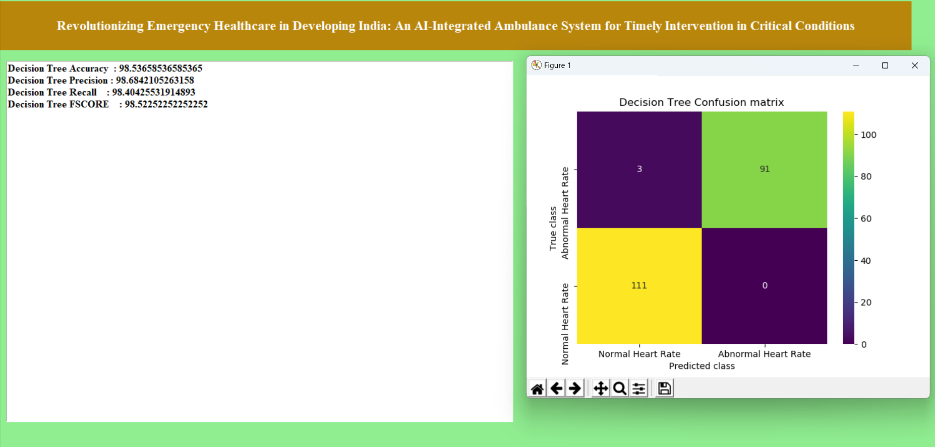
Running the Decision Tree Algorithm and displaying the performance evaluation and confusion matrix of the decision tree model

Slide 23
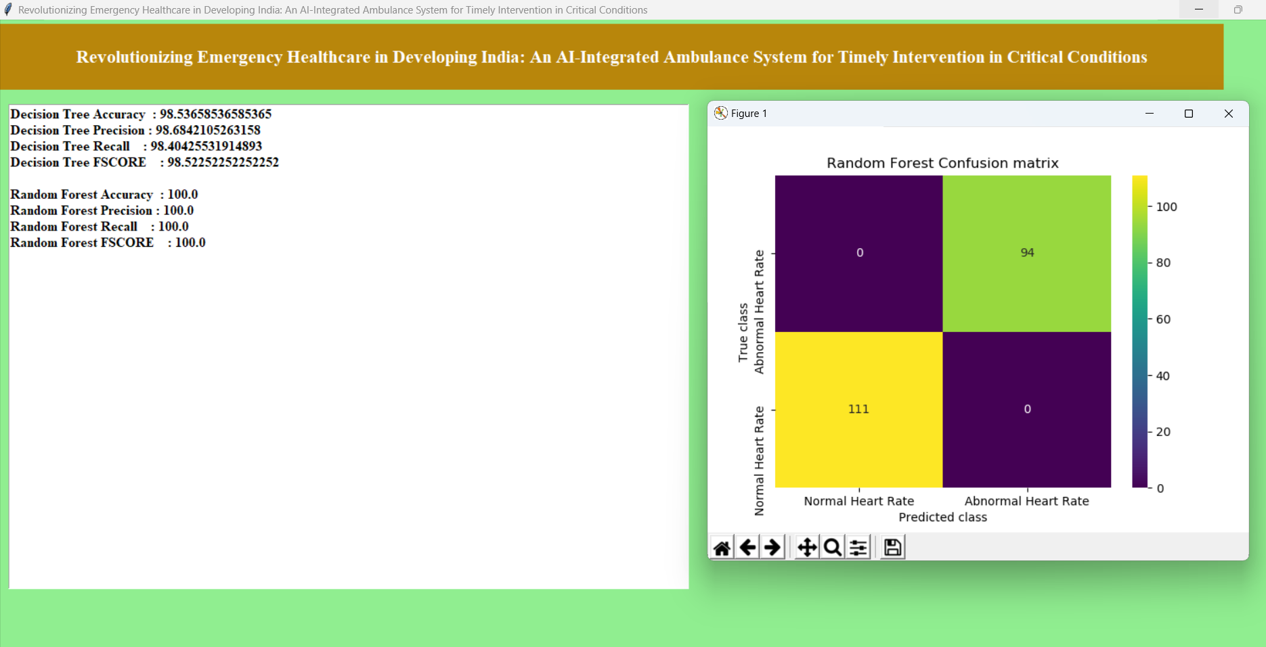
Running the Random Forest Algorithm and displaying the performance evaluation and confusion matrix of the random forest model

Slide 24
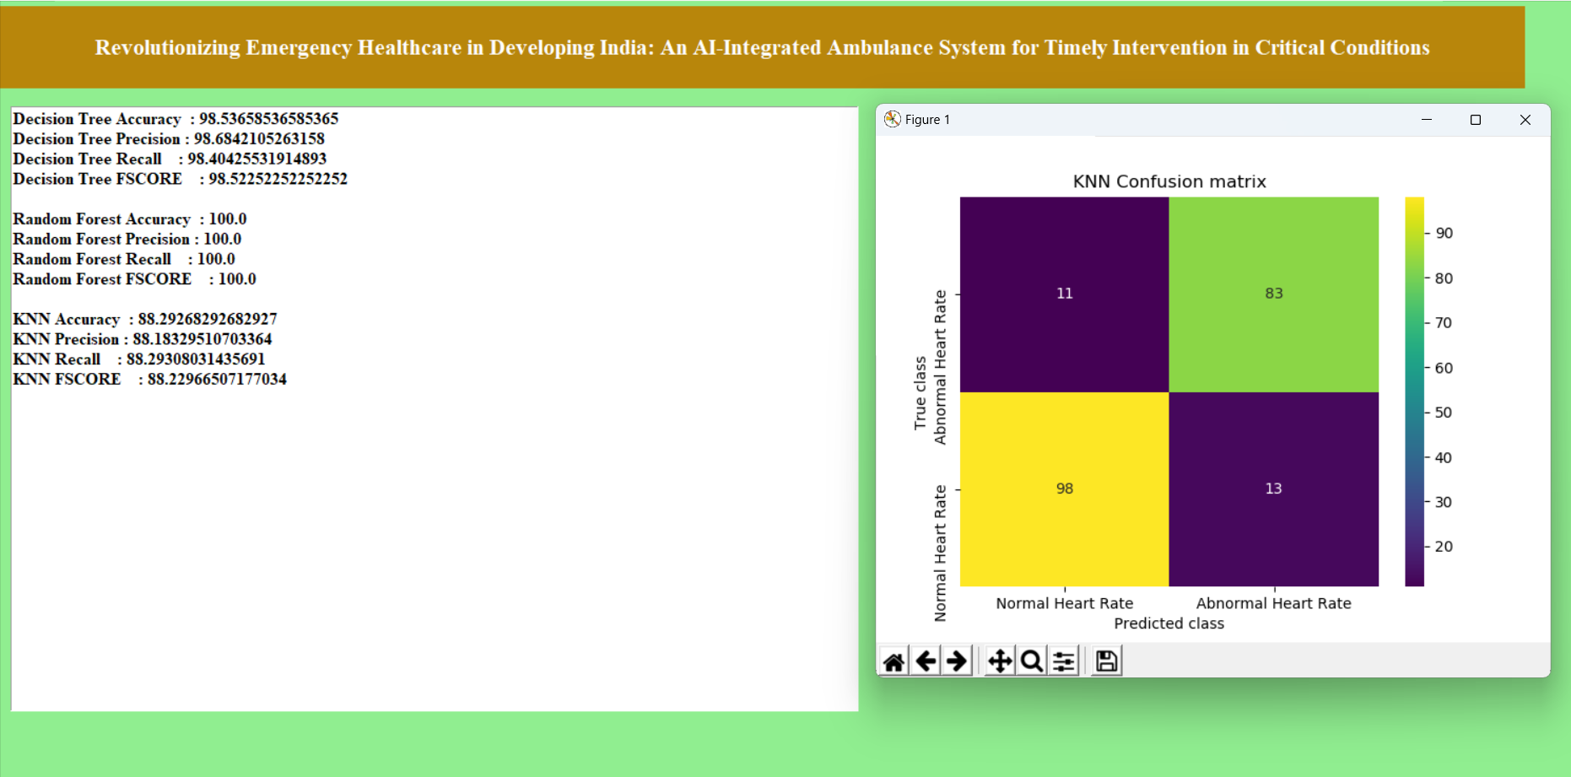
Running the K-Nearest Neighbors (KNN) Algorithm and displaying the performance evaluation and confusion matrix of the K-Nearest Neighbors (KNN) model

Slide 25
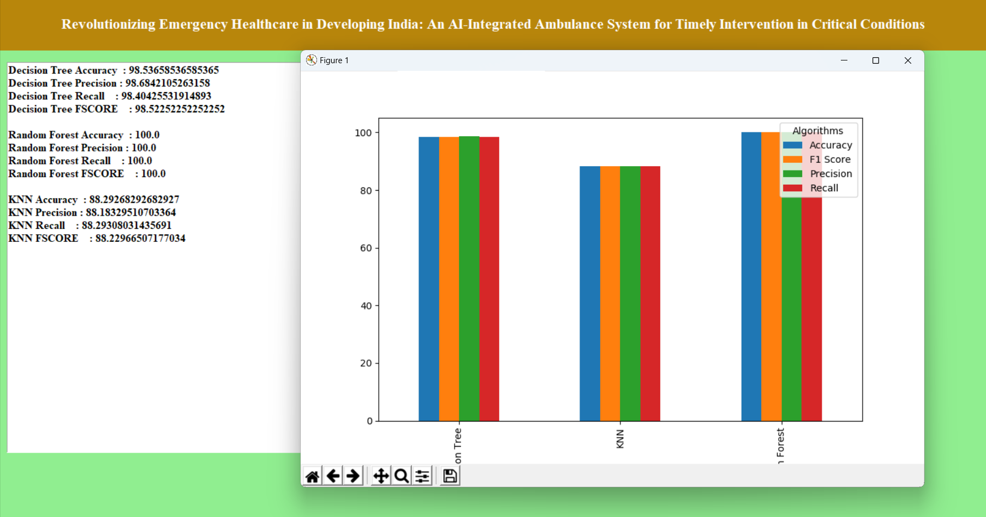
comparative analysis of performance metrics across the Decision Tree, Random Forest, and KNN models, helping users make informed decisions about model selection

Slide 26
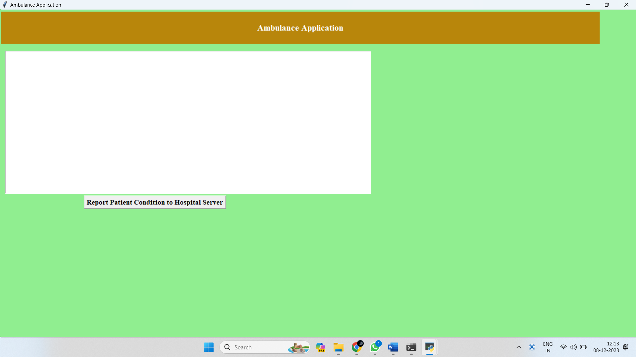

Interface for the ambulance reporting side :
Selecting the test dataset and reporting to hospital server :

Slide 27
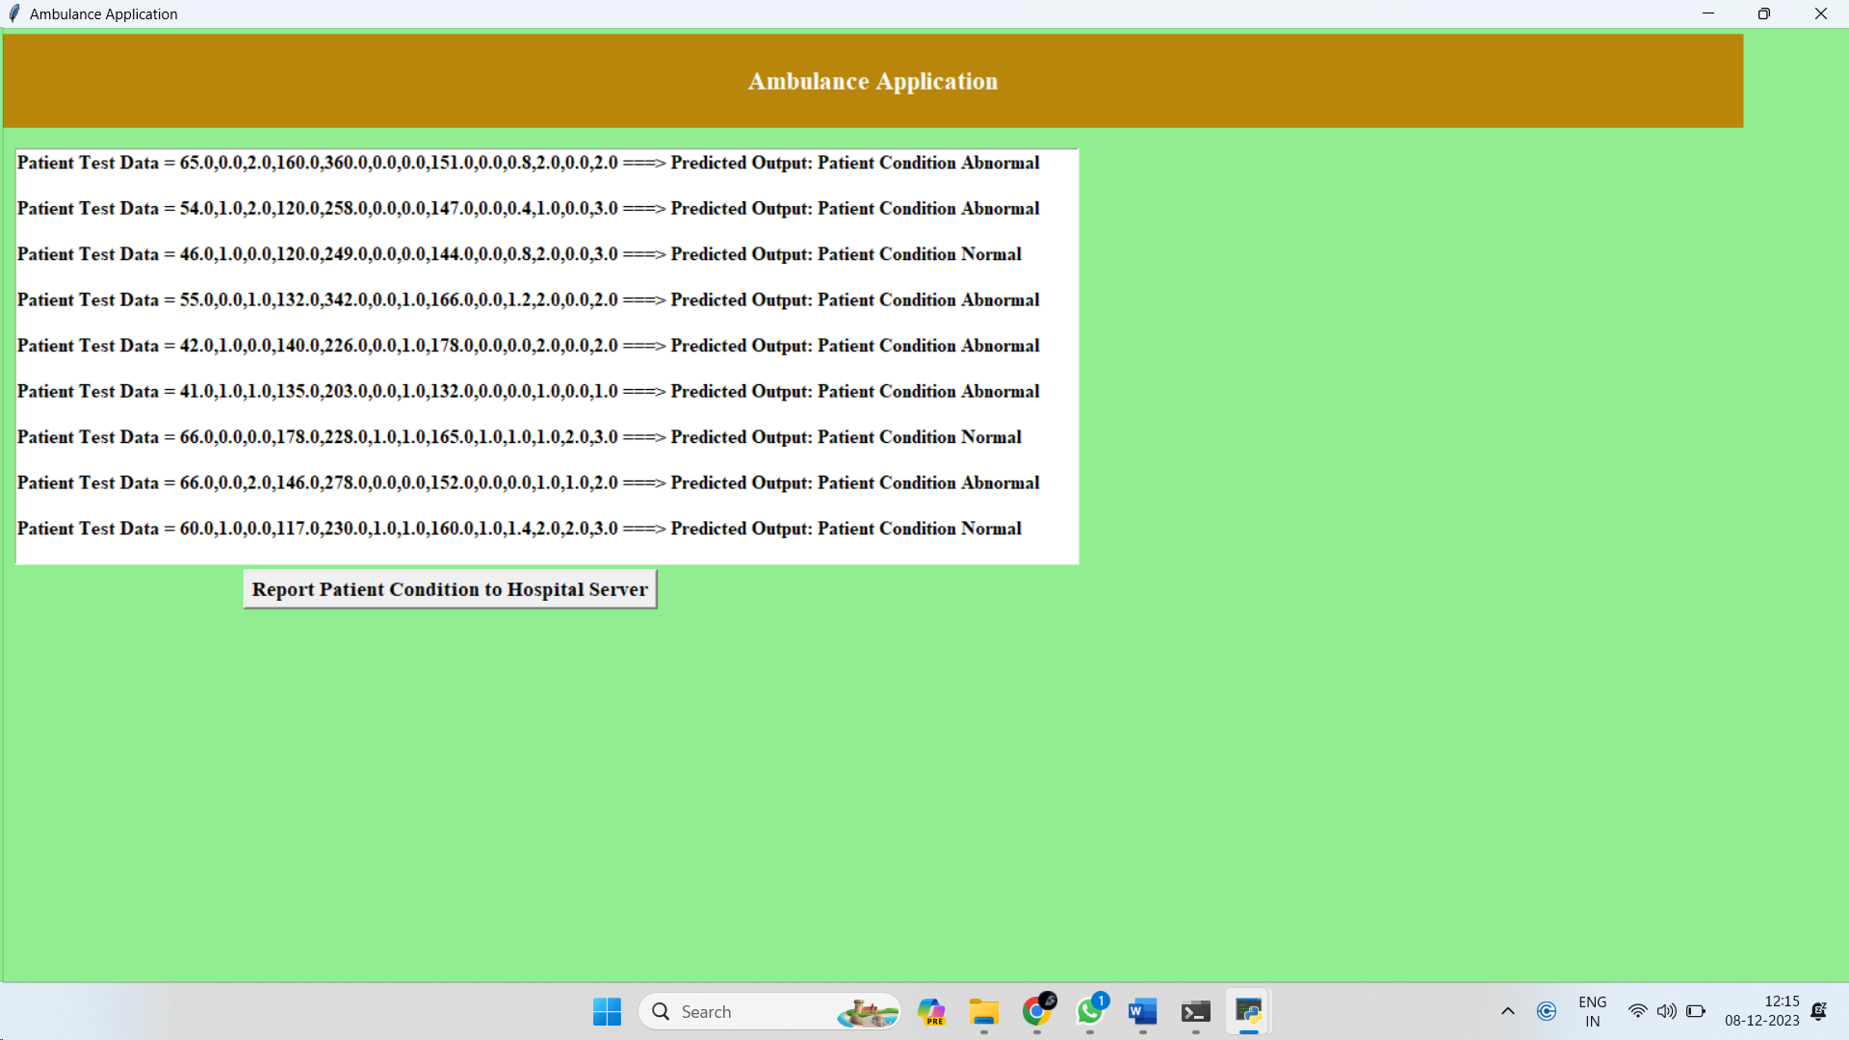
Displays the outcomes or predictions generated by the server model based on the test data received from the ambulance side

Slide 28
Applications
Early Detection and Intervention: AI algorithms can analyze patient data in real-time to detect critical conditions such as heart attacks, strokes, or trauma, enabling ambulance personnel to intervene promptly. This early detection can significantly improve patient outcomes and reduce mortality rates
Remote Consultation with Specialists: Integration with telemedicine platforms enables ambulance personnel to consult with specialists in real-time, even in remote or underserved areas. This facilitates timely expert guidance and improves the quality of care delivered to patients en route to the hospital
Advanced AI Diagnostics: Expanding the capabilities of AI within the ambulance for advanced diagnostics as a key focus. Integrating AI algorithms that can quickly analyze medical data, such as ECG readings or vital signs, can assist paramedics in making more informed decisions about patient care during transit.

Slide 29
SYSTEM AND PACKAGES REQUIREMENTS
Python IDLE 3.7 version
Jupyter
Tkinter
Numpy
Pandas
Matplotlib
Scikit-learn

Slide 30
CONCLUSION
The Intelligence Ambulance project, integrating AI and human interaction technologies, has showcased the potential for significantly improving emergency medical services.
The incorporation of artificial intelligence into ambulance systems, coupled with advanced human interaction technologies, has resulted in a more intelligent and responsive healthcare delivery system.
The project has demonstrated successful outcomes in terms of faster response times, accurate patient assessment, and improved communication between healthcare providers and patients.
The synergy between AI-driven decision support systems and human expertise has the potential to transform emergency medical care, enhancing both efficiency and patient outcomes.

Slide 31
FUTURE SCOPE
The Intelligence Ambulance project presents a transformative approach to emergency medical services, and future developments can further enhance its capabilities, ensuring that the integration of AI and human interaction technologies continues to contribute to more effective and responsive healthcare delivery in emergency situations.
It can expand the capabilities of AI within the ambulance for advanced diagnostics as a key focus. Integrating AI algorithms that can quickly analyze medical data, such as ECG readings or vital signs, can assist paramedics in making more informed decisions about patient care during transit.
It also Enhances the connectivity of the Intelligence Ambulance to enable seamless integration with telemedicine platforms can enable real-time consultation with healthcare professionals.
It Incorporates augmented reality (AR) technologies that can assist paramedics in various tasks, such as locating veins for intravenous access or providing step-by-step procedural guidance. AR can enhance the precision and speed of medical interventions in the field.

Slide 32
REFERENCES
Akash Bansode, Sanket Thakare, Sarthak Pawar, Subodh Wavhal and D.S. Rakshe, Smart Ambulance Management Application Using Cloud, IJARIIE-ISSN(O)-2395-4396, Vol-8, Issue-3 2022.
Divya Ganesh, Gayathri Seshadri, Sumathi Sokkanarayanan, Panjavarnam Bose, Sharanya Rajan and Mithileysh Sathiyanarayanan, “Automatic Health Machine for COVID-19 and Other Emergencies,” in IEEE-2021
Gargi Beri, Pankaj Ganjare, Amruta Gate, Ashwin Channawar, Vijay Gaikwad, “Intelligent Ambulance with Traffic Control”, Upper Indira Nagar, Bibvewadi, Pune, ISSN: 2454-5031, Volume 2 - Issue 5, May 2016. Design & Development of Intelligent Ambulance Concept – AI and Human Interface Technology Section A-Research paper 186 Eur. Chem. Bull. 2023,12(Special Issue 9), 177-188
Ms. Aisha Meethian, Althaf B.K., Athinan Saeed, Ligin Abraham, Mohammed Samran, “IOT Based Traffic Control System with Patient Health Monitoring For Ambulance”, ISSN:2395-5252, Volume 4, Issue 8, August 2022
Timothy Malche, Sumegh Tharewal, Pradeep Kumar Tiwari and Mohammad Aman Ullah, “Artificial Intelligence of Things- (AIoT) Based Patient Activity Tracking System for Remote Patient Monitoring”, 2022

Slide 33
THANK YOU!

